Slide 1
Types of study designs: from descriptive studies to randomized controlled trials
October 13, 2016
Derek Stephens
Dalla Lana School of Public Health

Slide 2
Objectives
To understand the difference between descriptive and analytic studies
To identify the hierarchy of study designs, and the strengths and weaknesses of each design
To be able to apply different study designs to the same research question

Slide 3
TWO STUDIES TO BE USED TO ILLUSTRATE DIFFERENT DESIGNS
UCSF medical school students
Femur Fracture @ sickkids (multicenter)

Slide 4


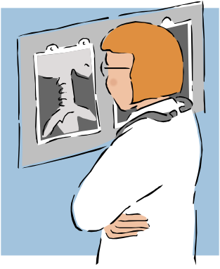
Research Question
Is the regular consumption of Red Bull
associated with improved academic
performance among U.S. medical students?

Slide 5
Femur Fracture study
Research Question: Does one type of surgery produce better healing in Femural fractures?
(Femur = thigh bone)
Outcome: Mal-union of Femur/Healing
Treatments/Surgical interventions
  X-fix
  External fixation is a method of holding broken bones in place. An external fixator has screws that are inserted into the bone
  Spica
  A hip spica cast is used to treat hip and thigh problems, most often in young children. The hip spica cast can be cumbersome etc…

Slide 6
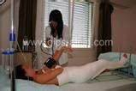
Hip Spica

Slide 7
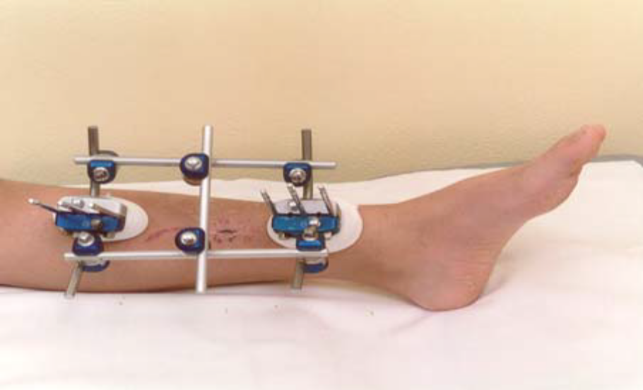
External Fixator

Slide 8
Types of Studies
Descriptive Studies
Observational Analytic Studies
  Cross Sectional studies
  Case Control studies
  Cohort studies
Experimental Studies
  Randomized controlled trials

Slide 9
Hierarchy of Study Types
Descriptive
Case report
Case series
Survey
Analytic
Observational
Cross sectional
Case-control
Cohort studies
Experimental
Randomized
controlled trials
Strength of evidence for causality between a risk factor and outcome

Slide 10
Descriptive studies
Getting a “lay of the land”
  Surveys
    How many types of surgery were done for femur fractures and respective success rates?
    Reporting of proportions, means, and measures of spread
Describing a novel phenomena
  Case reports or case series
    Sudden Infant deaths (SIDS)

Slide 11
Descriptive studies
Cannot establish causal relationships
Still play an important role in describing trends and generating hypotheses about novel associations
  Association between retinal hemorrhage and Shaken Baby Syndrome
Boxplots are a good way to show the central values and spread of the data.

Slide 12
Analytic Studies
Attempt to establish a causal link between a predictor/risk factor and an outcome.
You are doing an analytic study if you have any of the following words in your research question:
  greater than, less than, causes, leads to, compared with, more likely than, associated with, related to, similar to, correlated with

Slide 13
Research Question
Is the regular consumption of Red Bull
associated with improved academic
performance among U.S. medical students?

Slide 14
Red Bull
“Functional drink” designed for periods of mental and physical exertion.
  reported to increase performance, concentration, memory, vigilance, and emotional balance
  decrease reaction time…etc.
Taurine + glucuronolactone + caffeine

Slide 15
Great idea, but how do you get started….
Interesting, novel, and relevant, but…
You only have a very limited budget to start investigating this question.
What (design) is feasible?

Slide 16
Study Design #1
Cross-sectional study of UCSF medical students taking USMLE Step 2
Questionnaire administered when registering for USMLE 2
  Primary predictor: self-report of >3 cans Red Bull per week for the previous year
  Factors/Covariates: Age, sex, undergraduate university, place of birth
Outcome: Score on USMLE Step 2

Slide 17
Cross-sectional study: structure
Red Bull consumption
USMLE Score
time

Slide 18
Study 2 (Femur Fracture)
Cross-sectional study of patients at clinic visit 2 months
Questionnaire administered when registering for clinic visit at 2months postSx
  Primary predictor: Type of surgery
  Factors: Age, sex, centre
Outcome: Femur healed/not healed

Slide 19
Cross-sectional study: structure
Xfix/spica
Healed/Not
at2m
Time 2months post Sx

Slide 20
Cross-sectional Study:
Descriptive value:
  How many patients had type x-fix and of those how many healed at 2 months.
  How many patients had type spica and of those how many healed at 2 months.
  What is the age and sex distribution of patients having xfix and spica ?
Analytic value:
  Can the question of whether there is a difference in the 2 surgical treatments be answered using a cross-sectional design?

Slide 21
Cross-sectional Study: Pluses
+ Prevalence
+ Fast/Inexpensive - no waiting!
+ No loss to follow up
+ Associations can be studied

Slide 22
Cross-sectional study: minuses
- No time element
Red Bull consumption
USMLE Score
time

Slide 23
Cross-sectional study: minuses
- Cannot determine causality
- Cannot study rare outcomes

Slide 24
What if you are interested in the rare outcome?
The association between regular Red Bull consumption and…
  A perfect score on the USMLE – Step 2
  Graduating top 1% of the medical school class
  Acceptance into a highly selective residency
  (all of the above are examples of rare outcomes)

Slide 25
Leads us to Study Design #2
A case-control study
Cases: 4th year med students accepted to residency in “highly selective specialty X”.
Controls: 4th year med students who applied but were not accepted.
Predictor: self-reported regular Red Bull consumption
  Additional covariates (age, sex, medical school, undergraduate institution)

Slide 26
Case control studies (main feature)
Investigator works “backward” (from outcome to predictor)
Sample chosen on the basis of outcome (cases), plus comparison group (controls)

Slide 27
Case-control study structure
present
TARGET CASES
Medical students accepted to
highly selective residencies
ACTUAL CASES
4th year UCSF students
who matched in “highly
selective specialty X”
Red Bull consumption
YES
Red Bull consumption
NO
TARGET CONTROLS
All unsuccessful applicants to highly
selective residency programs
ACTUAL CONTROLS
4th year students who failed
to match in “highly selective
specialty X”
time

Slide 28
Case control studies
Can estimate the strength of the association between each predictor variable and the presence or absence of disease
Cannot yield estimates of incidence or prevalence of disease in the population (why?)
Odds Ratio is statistic used to measure association

Slide 29
Case-control Study: pluses
+ Rare outcome
+ Inexpensive and efficient: may be only feasible option
+ Establishes association (Odds ratio)
+ Useful for generating hypotheses (multiple risk factors can be explored)

Slide 30
Case-control study-minuses
Causality still difficult to establish
  Selection bias (appropriate controls)
    (controls should be matched as closely as possible to cases
    except on the exposure)
  Recall bias: sampling (retrospective)
  Cannot tell about incidence or prevalence

Slide 31
Recall bias
Recall or memory bias.
  subjects recall past events.
  Often a person recalls positive events more than negative ones.
  Alternatively, certain subjects may be questioned more vigorously than others, thereby improving their recollections.

Slide 32
Selection Biases
Selection biases.
  Occurs when the groups to be compared are different. These differences may influence the outcome. Common types of sample (subject selection) biases include volunteer or referral bias, and nonrespondent bias.

Slide 33
Selection of subjects in Case-Control designs
Controls must fulfil all the eligibility criteria defined for the cases apart from those relating to diagnosis of the disease.
In case–control studies, controls should represent the population from which the cases are drawn, i.e., they should provide an estimate of the exposure prevalence in the population from which the cases arise. If not, the results of the study are likely to be distorted because of selection bias.
In a nested case–control study, it is relatively straightforward to ensure that the cases and controls are drawn from the same study population, since both will arise from a clearly defined population⎯the cohort. In general, all the cases arising as the cohort is followed prospectively become the ‘cases’ in the case–control study, while a sample of unaffected members of the cohort become the ‘controls’.

Slide 34
Measures of association
 |  | Disease
 |  | Yes | No
Exp | Yes | a | b
 | No | c | d

Slide 35
Odds ratio: ad / bc
In the previous table a+c = number of cases. Of these a = number of the cases with the exposure. So an estimate of the proportion of exposed in disease = a/(a+c) and proportion of unexposed in disease = c/(a+c).
So Odds of exposure in diseased = [a/(a+c)]/[c/(a+c)] = a/c
  (note odds (of an event) = p/(1-p))
Similarly odds of exposure in controls =b/(b+d)/d/(b+d) = b/d
So odds ratio of exposure in diseased = ratio of the above odds = ad/bc
A measure of the “likelihood” of exposure given disease

Slide 36
Measures of association. Relative Risk
Risk ratio (relative risk)
A
A + B
C
C + D
Forward direction
 |  | Disease
 |  | Yes | No
Risk Factor | Yes | A | B
 | No | C | D

Slide 37
Equivalence of OR and RR
When is ad/bc approximately equal to [a/(a+b)]/[c/(c+d)]
If a << b then a+b ~ b
If c << d then c+d ~ d
Then [a/(a+b)]/[c/(c+d)] = [a/b]/[c/d]
Which is ad/bc
Equivalence holds when prevalence is low

Slide 38
Where are we in answering research question #1
(Say) Preliminary results from our cross-sectional and case-control study suggest an association between Red Bull consumption and improved academic performance among medical students
What’s missing? - strengthening evidence for a causal link between Red Bull consumption and academic performance
Use results from our previous studies to apply for funding for a prospective cohort study!

Slide 39
Study design #3
Prospective cohort study of UCSF medical students Class of 2009
All entering medical students surveyed regarding beverage consumption and variety of other potential covariates
Survey updated to record changes in Red Bull consumption
Outcomes: USMLE score, match in first choice residency

Slide 40
Cohort studies
A cohort (follow-up, longitudinal) study is a comparative, observational study in which subjects are grouped by their exposure status, i.e., whether or not the subject was exposed to a suspected risk factor
The subjects, exposed and unexposed to the risk factor, are followed forward in time to determine if the disease occurs
  Subjects should be disease free on entry(i.e. USMLE score is not known)
  No new subjects allowed in after initial recruitment
The rates of disease incidence among the exposed and unexposed groups are determined and compared.

Slide 41
Elements of a cohort study
Selection of sample from population
  Problems: self select, physician selected
Measures of predictor variables in sample
Follow population for period of time
  For prospective/retrospective there is a time element, Forward/backward, respectively)
  Same follow up time for all groups being followed
Measure outcome variable

Slide 42
Prospective cohort study structure
Red represents Red Bull consumption
The present time T0
Outcome at a future time T1
Top USMLE scorers
Everyone else
time

Slide 43
Strengths of cohort studies
Know that predictor variable was present before outcome variable occurred (some evidence of causality)
Directly measure incidence of a disease outcome
Can study multiple outcomes of a single exposure (RR is measure of association)

Slide 44
Weaknesses of cohort studies
Expensive and inefficient for studying rare outcomes
Often need long follow-up period or a very large population
Loss to follow-up can affect validity of findings

Slide 45
Other types of cohort studies
Retrospective cohort
  Identification of cohort, measurement of predictor variables, follow-up and measurement of outcomes have all occurred in the past
  Much less costly than prospective cohorts since often a chart review.
  Investigator has minimal control over study design

Slide 46
Other types of cohort studies
Nested case-control study
  Case-control study embedded in a cohort study offers impressive reductions in costs and efforts of data collection and analysis compared with the full cohort approach, with relatively minor loss in statistical efficiency
  Controls are drawn randomly from study sample
  Matching controls to cases within the cohort could make the design more efficient.

Slide 47
Other types of Cohort Designs
Crossover designs
Each patient receives both(all) treatments
  Usually requires fewer subjects variance is smaller than independent samples design
  [σ²(d) = σ²(1) + σ²(2) -2ρσ(1)σ(2) ]
  What happens if the correlation ρ is < 0?
  Serious problem is the carryover effect of the treatments, if sufficient Washout is not built in.
  If carryover effect is observed then can only use first time point measurements
  Power decreases

Slide 48
Hierarchy of Study Types
Descriptive
Case report
Case series
Survey
Analytic
Observational
Cross sectional
Case-control
Cohort studies
Experimental
Randomized
controlled trials
Strength of evidence for causality between a risk factor and outcome

Slide 49
What distinguishes observational studies from experiments?
Ability to control for confounding
Confounder
Predictor
Outcome
Examples:
  sex (men are more likely to drink red bull and men are more likely to match in neurosurgery)
  Undergraduate institution (students from northwest school are more likely to drink red bull and also more likely to score higher on
  USMLE)

Slide 50
But we measured all of the potential confounders…….
In an observational prospective cohort study you can (maybe) measure all potential known confounders, but…
You can’t control for unanticipated or unmeasured confounders. (i.e. unknown variables)

Slide 51
Brings us to Study Design # 4
The RCT
Randomized controlled trial of daily Red Bull consumption among entering UCSF medical students Class 2009
Randomly allocate students to daily consumption of Red Bull vs. daily consumption of placebo (May not be feasible how can this be done for the Red Bull question)
Outcome: USMLE Step 1 score, USMLE Step 2 score, match in first choice residency

Slide 52
Randomized Controlled Trials
Investigator controls the predictor variable (intervention or treatment)
Major advantage over observational studies is ability to demonstrate causality
Randomization used to control unmeasured or unknown confounding variables.
Only for mature research questions

Slide 53
Basic Trial Design
Population
Red Bull
Score
Med. students
Randomization : Is this possible?
Control
Placebo
Score

Slide 54
Back to surgical Femur Fracture trial
Can best be answered using this design.
Randomization more feasible in this example
spica
Healed/Not Healed
Femur fractures
Randomization
xfix
Healed/Not healed

Slide 55
Steps in a randomized controlled trial
Select participants(inclusion criteria)
  high-risk for outcome (high incidence)
  Likely to benefit and not be harmed
  Likely to be compliant
    (to avoid problems of missing data)
Measure baseline variables
Randomize
  Eliminates baseline confounding
  Randomization could be simple, stratified, block

Slide 56
Steps in a randomized controlled trial
Blinding the intervention
  As important as randomization
  Eliminates
    biased outcome ascertainment
    biased measurement of outcome
Follow subjects
  Adherence to protocol
  Lost to follow up
Measure outcome
  Clinically important measures
  Adverse events

Slide 57
What is Blinding?
Single blind - participants are not aware of treatment group
Double blind - both participants and investigators unaware
Triple blind - various meanings
  persons who perform tests
  outcome adjudicators
  safety monitoring group

Slide 58
Why blind?:
Biased Outcome Ascertainment
If group assignment is known
  participants may report symptoms or outcomes differently
  physicians or investigators may elicit symptoms or outcomes differently
  Study staff or adjudicators may classify similar events differently in treatment groups
More Problematic with “soft” outcomes
  investigator judgment
  participant reported symptoms, scales

Slide 59
Analysis of RCT
Analyzed like cohort study with RR or GLM/Mixed analysis(for continuous type outcomes)
Don’t need to adjust for baseline scores.
Intention to treat analysis
  Most conservative interpretation
  Include all persons assigned to intervention group (including those who did not get treatment or dropped out)

Slide 60
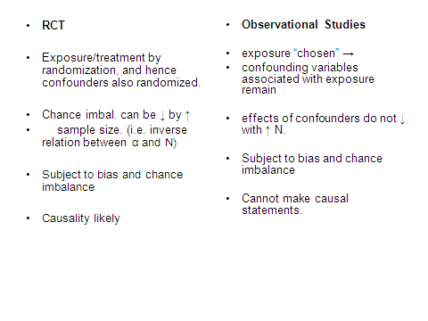

Slide 61
Features of High Quality Randomized Trials
Tamper-proof randomization
Blinding of participants, study staff, lab staff, outcome ascertainment and adjudication
Adherence to study intervention and protocol
Complete follow-up

Slide 62
Equivalence Trials (optional slides)
Some studies seek to show that treatments are NOT different.
These are called equivalence trials
In a comparative(difference) trials the standard analysis uses statistical significance tests to determine whether the null hypothesis of "no difference" may be rejected, together with confidence limits to place bounds on the possible size of the difference between the treatments.
  Null: Mean1 = Mean2
  Alternative: Mean1 ≠ Mean2

Slide 63
Equivalence Trials
In an equivalence trial the conventional significance test has little relevance: failure to detect a difference does not imply equivalence
A difference which is detected may not have any clinical relevance and may correspond to practical equivalence.
The relevance of the confidence interval, however, is easier to see.

Slide 64
Equivalence Trials
The CI defines a range for the possible true differences between the treatments, any point of which is reasonably compatible with the Null Hypothesis. If every point within this range does not correspond to a clinically important difference then the treatments may be considered to be equivalent.
A margin of equivalence must be specified before the study.

Slide 65
Equivalence Trials
If we have predefined a range of equivalence as an interval from - to + we can then simply check whether the confidence interval centered on the observed difference lies entirely between - and + .
If it does, equivalence is demonstrated; if it does not, there is still room for doubt.
It is important to emphasize that absolute equivalence can never be demonstrated
It is possible only to assert that the true difference is unlikely to be outside a range which depends on the size of the trial(N), the results of the trial(δ,σ) and the specified probabilities of error(α, β).

Slide 66
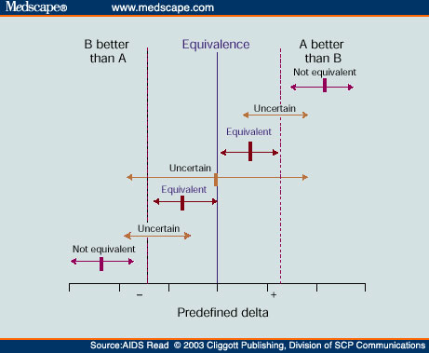
Equivalence Trials

